Slide 1


Myanmar Poetry Classification
Phyo Myat Oo
(Dedicated to Sai Phyo Thu Htet)

Slide 2
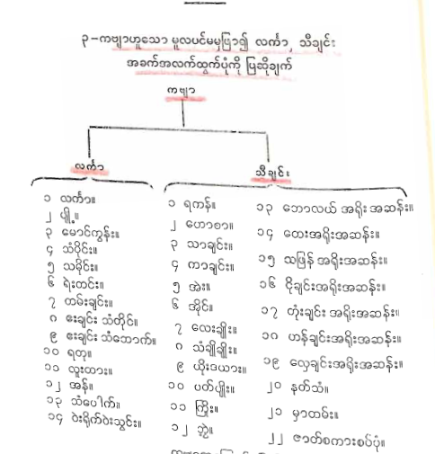

Project Introduction
Goal: To classify Myanmar poems using NLP.
Initial Discovery: A surprising number of poetry types existed.
Main Categories:
ခေတ်ပေါ်ကဗျာ (Modern), ရိုးရာကဗျာ (Traditional).
Traditional Sub-categories:
လင်္ကာ (Linga) and သီချင်းကဗျာ (Thachin).
Total : Wiki (36 types), Facebook (72 types).

Slide 3
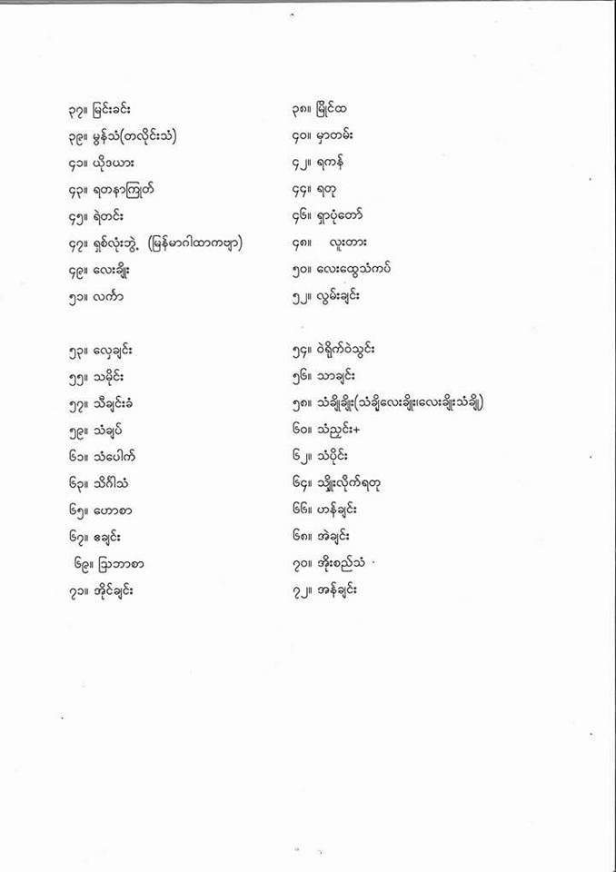
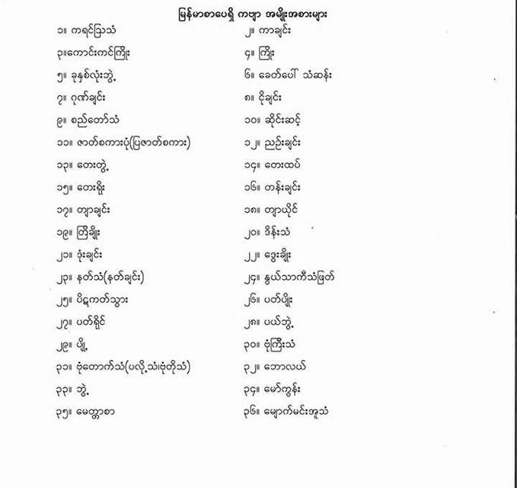
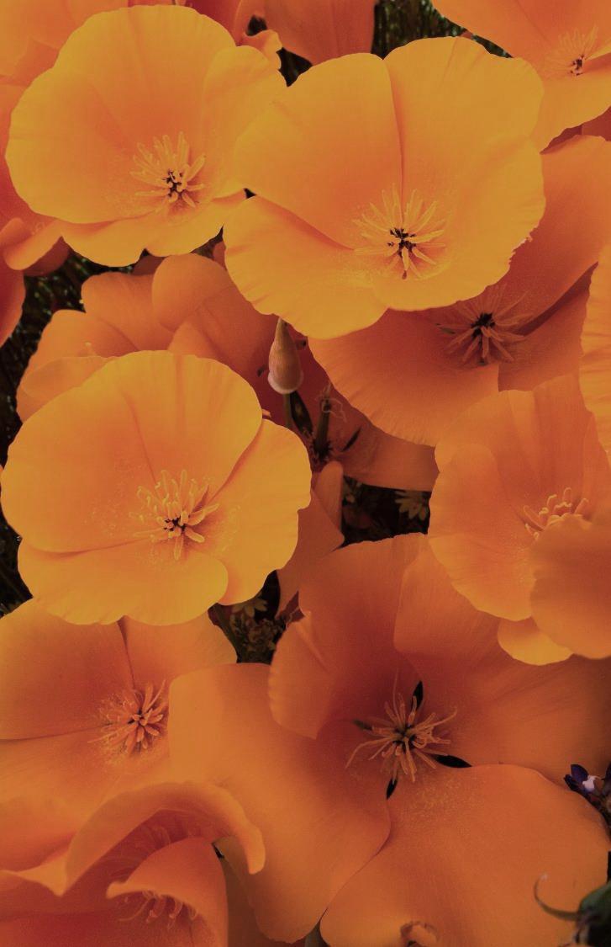
Overcoming nervousness
Confidence-building strategies

Slide 4
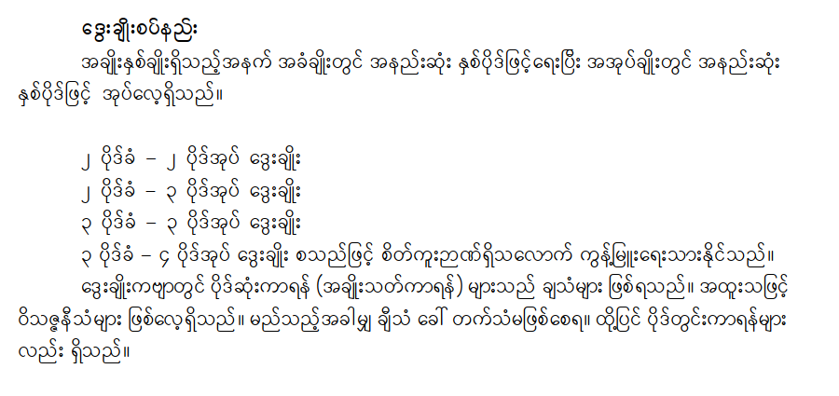
Overall Project Plan
Step 1:
Deep Learning Model with 3 main labels:
ခေတ်ပေါ်ကဗျာ (Modern Poetry), လင်္ကာ (Linga), သီချင်းကဗျာ (Thachin)
Step 2 (Rule-Based): If classified as လင်္ကာ (Linga), use a rule-based system for further sub-classification.

Slide 5
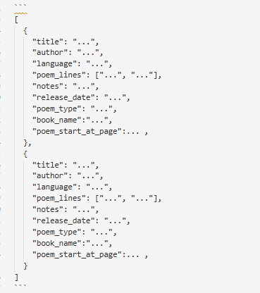
Challenge 1: Data Acquisition
Problem: Data resources နည်းပါးခြင်း (Low data resources).
No readily available datasets.
Solution: OCR ကို အသုံးပြု၍ စာအုပ်များမှ data ဖတ်ယူခြင်း (Used OCR to read data from books).
- Gemini AI studio ကို သုံးပြီး JSON format ထုတ်ယူခြင်း (Used Gemini API to extract JSON format data)
New Problem: OCR/Gemini error များ (Errors from OCR/Gemini).
Solution: Poem Editor ကို ဖန်တီး၍ data သန့်ရှင်းခြင်း (Created a Poem Editor to clean data).

Slide 6
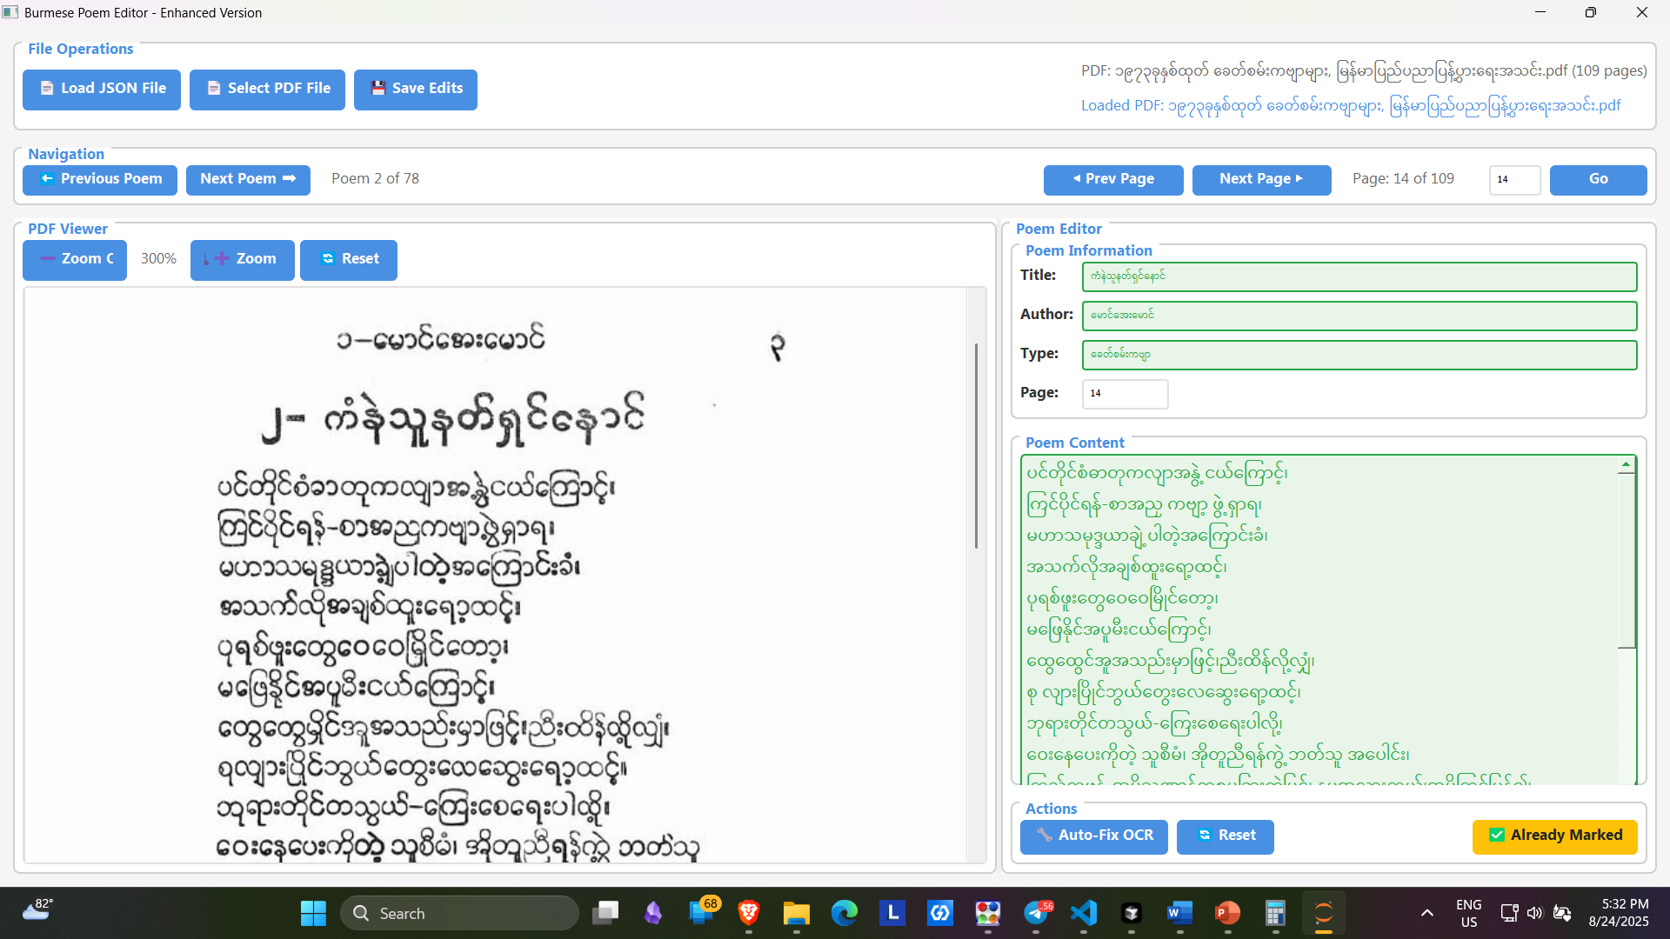

Slide 7
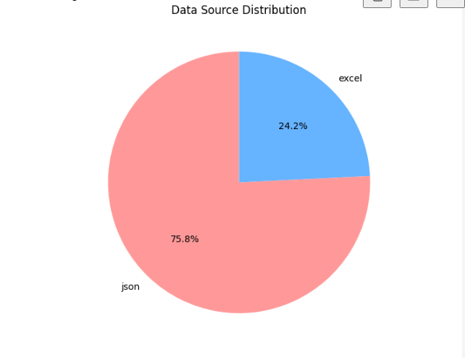
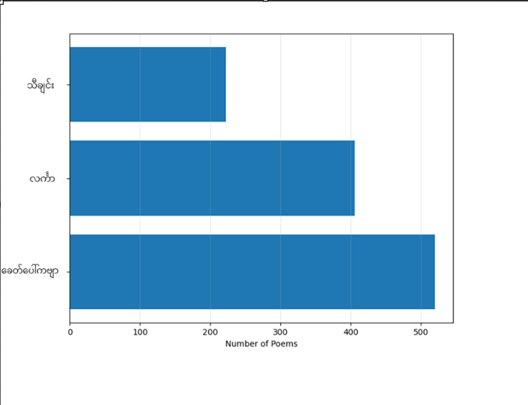
Result: Total of 1148 data points collected
Poem type distribution: ခေတ်ပေါ်ကဗျာ: 520
လင်္ကာ: 406
သီချင်း: 222

Slide 8
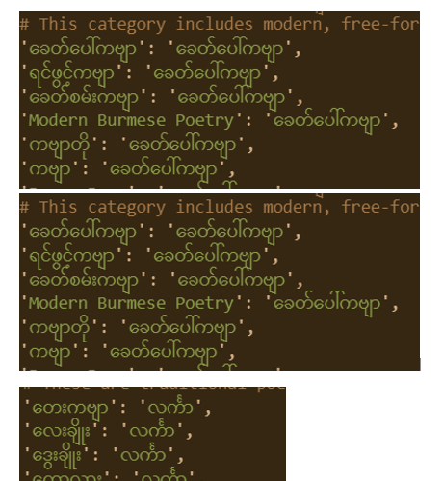
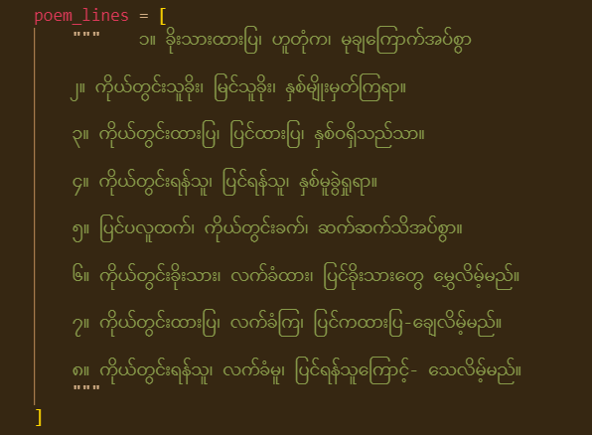
Challenge 2: Data Preprocessing
Problem: Inconsistent poem formats
Solution: Used Regular expression to standardize formats).
Summary: Data Collection and Cleaning complete!
What we get here is standard feature that can be used in Model Training
For label – map the output from Gemini to 3 types of main categories and encode them .
ခေတ်ပေါ်ကဗျာ = [0,1,0]

Slide 9
Model Training - Tokenization
Data Split: 80 % Train, 20 % Test.
Tokenization:
1. Character Tokenization: "နက္ခတ္တ" => "န က ္ ခ တ ္ တ„
2. Custom Syllable Tokenization: "နက္ခတ္တ" => "နက် ခတ် တ”
Basis: ဆရာရဲကျော်သူ (Based on the work of Saya Ye Kyaw Thu).
Why Syllable Tokenization? (This will be explained later in the presentation).
Process: Tokens -> Numerical Sequence -> Model Input.
: "နက္ခတ္တ" => "နက် ခတ် တ” => [10, 20, 30] =>Model input

Slide 10
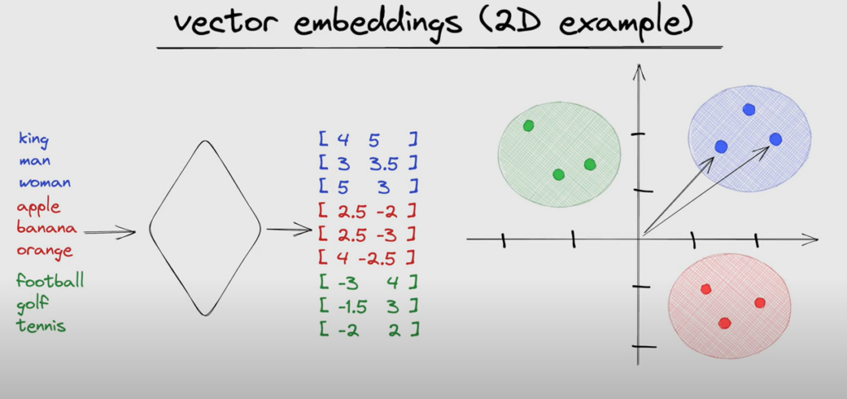
Deep Learning Architectures
Models Explored: LSTM
CNN
Transformer
Steps:
Embedding Layer: Transforms words into numerical vectors.
Dense & Dropout Layers: Produces the final classification output.

Slide 11
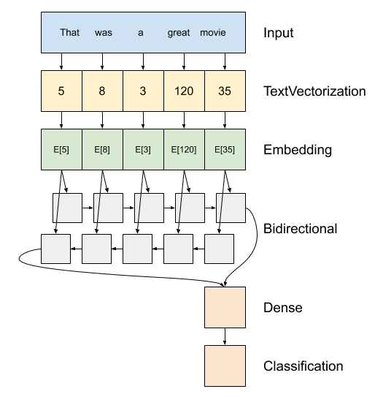
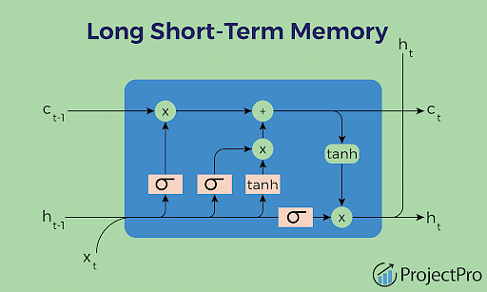
LSTM Architecture
Core Concept:
Cell State and Gates (Forget, Input, Output).
Analogy: A "conveyor belt" that remembers or forgets information over time.
Architecture: Used a Bidirectional LSTM, which processes text from both directions to better understand context.
Use Case: Excellent for handling long sequences of text with long-term dependencies.

Slide 12
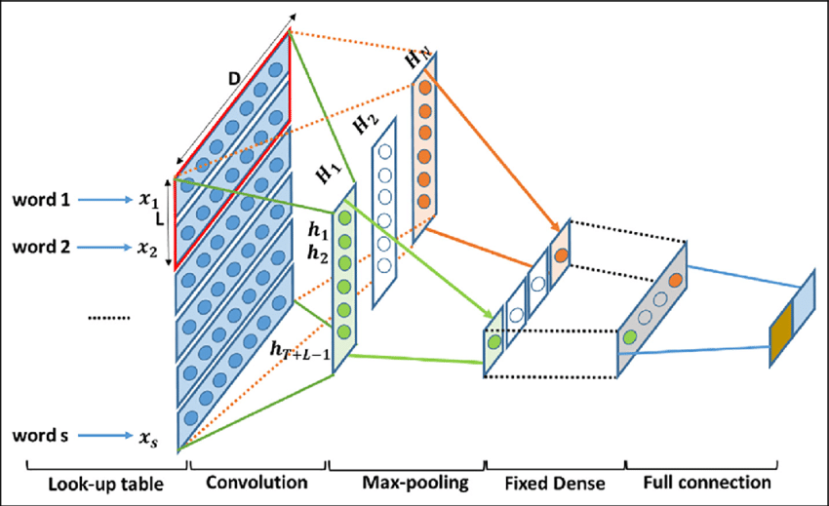
CNN Model
Core Concept: 1D CNNs are effective at finding local patterns (like n-grams) in text.
Architecture:
Conv1D Layers: Scan for important patterns.
GlobalMaxPooling1D: Extracts the most significant features.
Use Case: Effective for text classification by identifying local features.

Slide 13
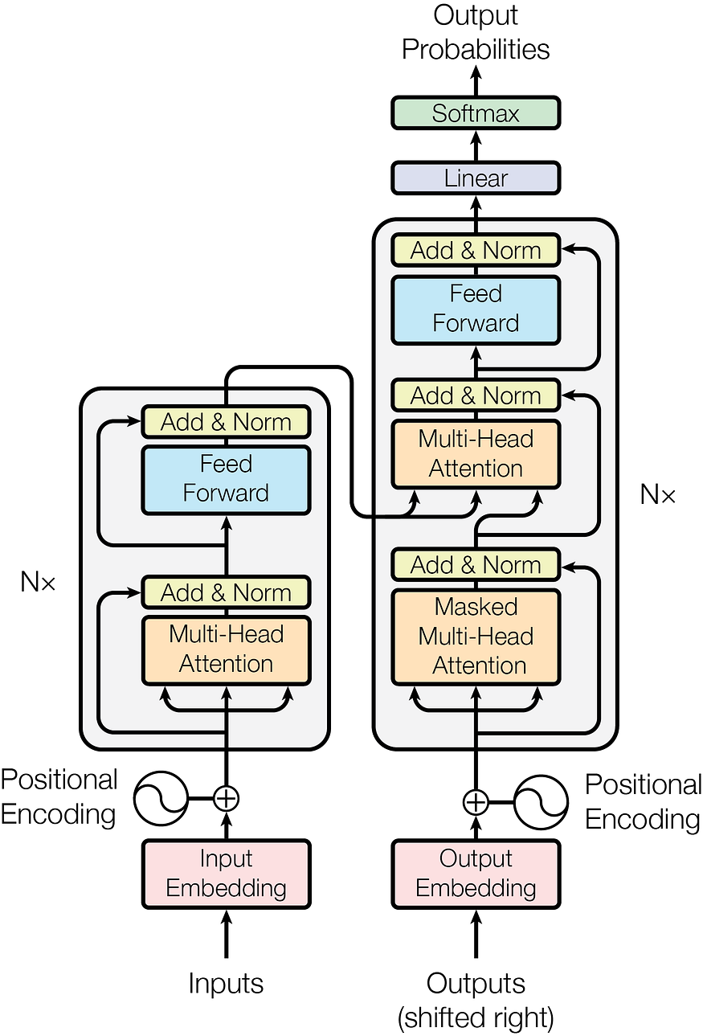
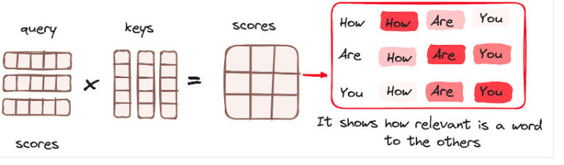
Transformer Model
Core Concept:
The Attention Mechanism.Analogy: The model "pays attention" to the most relevant words in a sentence to understand a specific word's meaning.
Key Components:
Self-Attention: Calculates how much each word should "attend" to every other word.
Multi-Head Attention: Allows the model to focus on different types of relationships simultaneously.
Use Case: Superior for handling long-range dependencies in text.

Slide 14
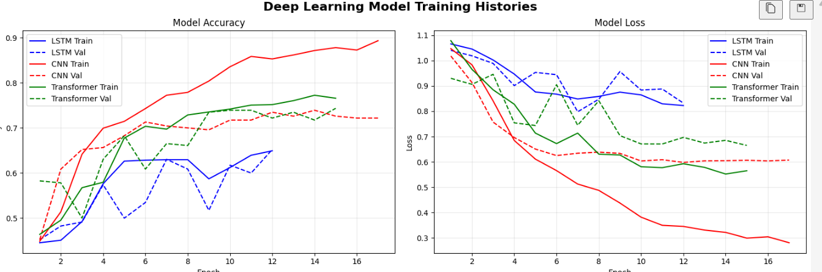
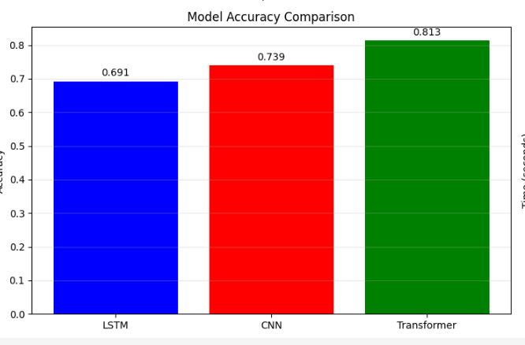
Result of training with Character tokenization
Best model
Transformer with 0.7435 accuracy

Slide 15
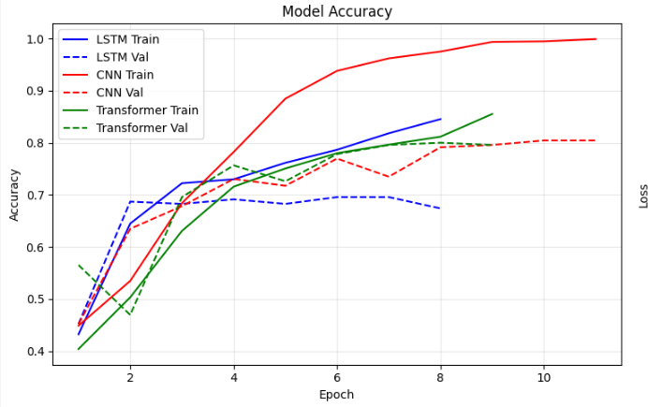
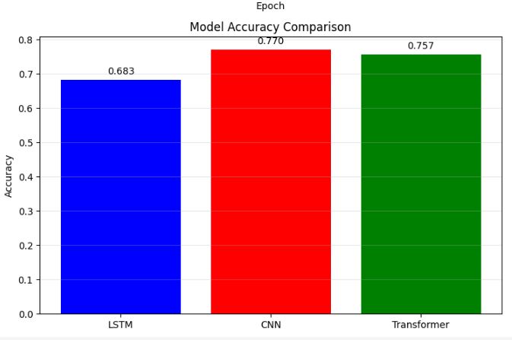
Result of training with Custom syllable tokenization
Best model:
CNN with 0.7696 accuracy

Slide 16

Step 1. Rule-Based Poem Classification for Linga
Objective: To further classify poems identified as Linga based on their structure.
Method: A rule-based workflow that analyzes rhyme and structure.
Why a Rule-Based Approach?
It allows for precise classification of traditional poetry where rules for rhyme (kayan) and lines are well-defined.
Currently – Only Than Bouk ( သံပေါက်) rule based is implemented.
မောင်ကတီကုံး၊
စပယ်ကုံး(မို့)၊
မယ်ကတုံးက မပန်သာ။

Slide 17
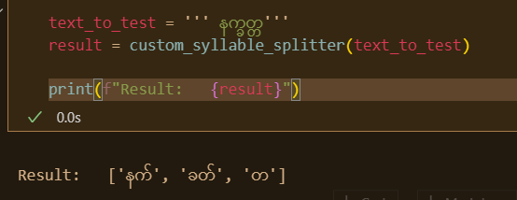
The Syllable Tokenization Advantage
The Problem: Standard word tokenization, like "နက္ခတ္တ" -> "န, က္ခ, တ္တ", is not effective for rhyme analysis.
The Solution: custom syllable tokenization, “
နက္ခတ္တ" -> "နက်, ခတ်, တ", accurately identifies the final consonant (that), which is crucial for rhyme.

Slide 18
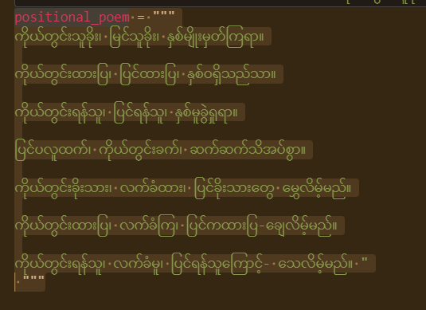
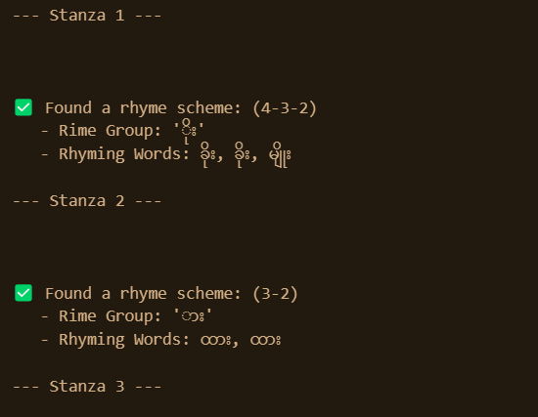
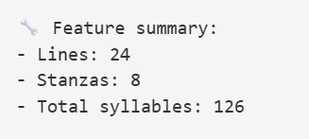
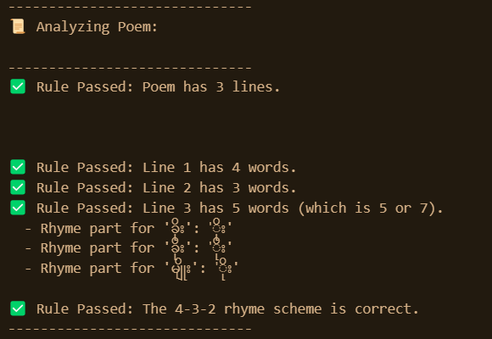
The Rhyme and Stanza Rules
Step 1: Rhyme Grouping
Step 2: Rhyme Chain Identification
Step 3: Final Classification:

Slide 19
Summary & Next Steps
Summary of Work:
Created dataset collection workflow from scratch
Standardized poem formats.
Experimented with 3 deep learning architectures (LSTM, CNN, Transformer).
Explored two tokenization methods.
Determine the best model and tokenization method for this task.
Further explore the rule-based classification for Linga poetry

Slide 20
Thank you to everyone
Phyo Myat Oo

Slide 21
FAQ

